Slide 1



Slide 2

Diet and health

Slide 3

Our main aim
To speak about healthy eating habits and dieting.

Slide 4

English proverbs
Early to bed early to rise make a man healthy, wealthy and wise.
An apple a day keeps a doctor away.
Eat to live, not live to eat.

Slide 5
Match the words and their definitions
1. Meat | a) builds strong teeth and bones by providing Calcium.
2. Dairy | b) helps us to have strong and healthy body by providing protein.
3.Fruits and vegetables | c) are fast sources of energy.
4. Bread and cereal | d) help us to have healthy gums, good eyesight by providing Vitamins A and C.
5.Fats and sugars | e) gives us energy by providing protein, iron, and several B vitamins.

Slide 6
Explain the words
Overweight –
Underweight –
Lack of concentration –
Tiredness –
Tooth decay –
Frequent illness –
Indigestion –
Dry skin -
too fat
below the normal weight
not enough of concentration
feeling that you want to sleep or rest
when tooth are slowly destroyed
being ill very often
pain that you get when your stomach cannot break down food that you have eaten
having no water in skin

Slide 7

Overweight
Eat less and take regular exercise

Slide 8
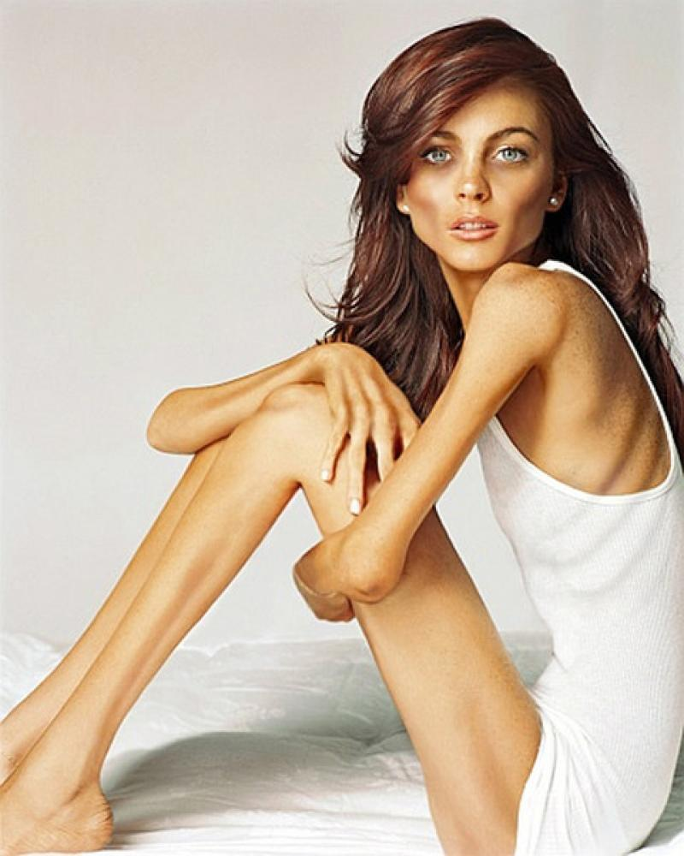
Underweight
Eat three well-balanced meals and three or four snacks per day

Slide 9

Lack of Concentration
Eat lots of iron-rich foods and have a good breakfast

Slide 10

Tiredness
Follow a low-carbohydrate diet

Slide 11
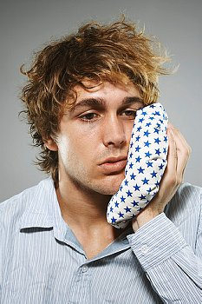
Tooth decay
Cut out sugary drinks and snacks

Slide 12

Frequent illness
Eat foods rich in vitamin C

Slide 13
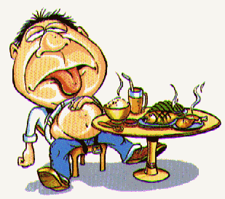
Indigestion
Avoid spicy foods and eating fast or late at night

Slide 14

Dry skin
Drink more water and eat more oily fish, nuts and seeds

Slide 15
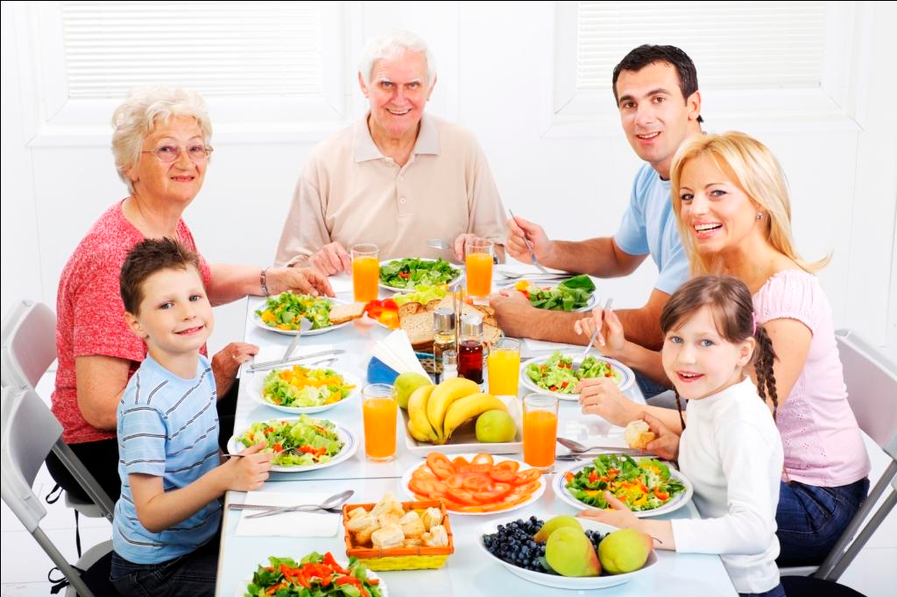
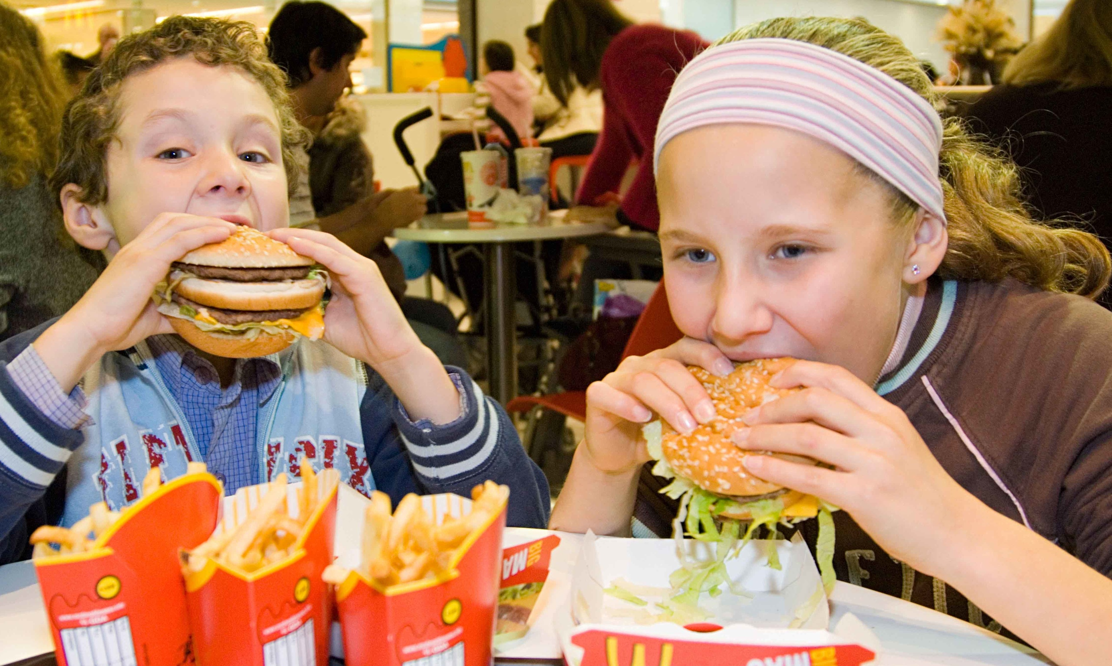
Describe and compare two pictures

Slide 16

Reflection
We spoke about…
We learned….
We tried to…

Slide 17

Crush diet

Slide 18
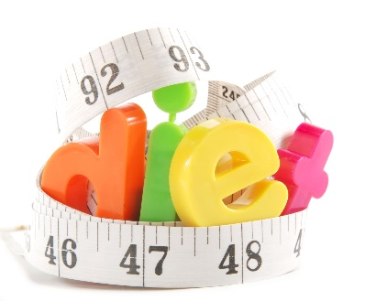
Are you a fan of dieting ?
FOR
AGAINST

